Slide 1
Cross-straitization between China and Taiwan: How Educational Exchange works for Peace?
Chuing Prudence CHOU 周祝瑛
Fulbrighter and Professor,
Department of Education
National Chengchi University, Taiwan
16th Annual International Conference on Education, Athens, May 19-22, 2014

Slide 2
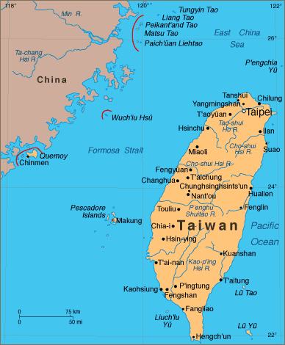

Slide 3
Spot Light : Taiwan
Area :36,000 square kilometers
Population: 23 million
Capital : Taipei City
Language : Mandarin/Taiwanese/Hakka/Indigenous Languages
Religion : Buddhism/Taoism/Christianity/Islam

Slide 4
Educational philosophy:
A Credential Society, efforts over innate abilities
Confucian heritage: group-oriented, academic success, respect for teachers, exam-oriented
A capital society:
Supplement Education

Slide 5
A Statistical Comparison
CHINA (People’s Republic of China)
3,706,566 square miles
Pop:1.27 billion
TAIWAN (Republic of China)
13,969 square miles
pop: 22.42 million

Slide 6
The Taiwan Cross-strait relationship has been highly politicized since 1949 when KMT government withdrew from China to Taiwan.
But the educational exchange has made a huge progress since 1990s.

Slide 7
Development of the Cross-strait Exchanges
Since1987, Taiwan granted more access to Chinese professionals to visit Taiwan in 1993.
Since 1979, the first Taiwanese student went to China for higher education.

Slide 8
More than thirty- thousand Taiwanese students have studied in Chinese higher education since 1980s.
More than twenty- thousand Chinese students have studied in Taiwan’s higher education since mid-1990s.

Slide 9
Theories
Yale Richmond:
Cultural Exchange and the Cold War: Raising the Iron Curtain” (University Park: Penn State University Press, 2003)
Gordon Allport (1954):
Contact Hypothesis

Slide 10
Definition: cross-straitization
The unique model is prioritizes on cultural and educational exchanges .
Within such model, acceptable forms of communication based on mutual respect
and understanding are being accomplished.

Slide 11
Conflict or Peace
Cross-straitization is a channel to facilitate Taiwan’s sustainable coexistence with China and the rest of the world.
A demonstration in contrast with the competing forces between the former West-East Berlin, and North-South Korea.

Slide 12
Social Context
In September of 2011, more than 900 Chinese students were admitted as degree-seekers to study in Taiwan universities.
While, the number of short-term exchange programs numbered by the thousands.

Slide 13
Research Objective
The primary objective is to understand the mainland Chinese students’ perceived study experiences in Taiwan.
What are the students’ study experiences?
What are the students’ push-pull factors in study abroad?

Slide 14
Findings
In addition to knowing the culture first hand, the mainland Chinese students’ major pull factors are:
the opportunity to travel and experience life in Taiwan, various curriculum programs availability, numerous cultural related activities, shopping experiences, and healthy lifestyle.

Slide 15
Conclusion
With the current emphasis on doing businesses in China, understanding how mainland Chinese students react in a new environment is a step towards better future cooperation.
This study shall provide new insights in the paradigm shifts from internationalization into a cross-straitization of higher education institutions in Taiwan.

Slide 16
For more information, please refer to
Chou and Ching (2015). Cross-Straitization of Higher Education: Voices of the Mainland Chinese Students Studying in Taiwan
International Journal of Information and Education Technology, Vol. 5, No. 2, February 2015.

Slide 17
Thank you for your attention!
Chou, Chuing Prudence
E-mail: iaezcpc2007@gmail.com
Website: http://www3.nccu.edu.tw/~iaezcpc/English%20index.htm

